Slide 1
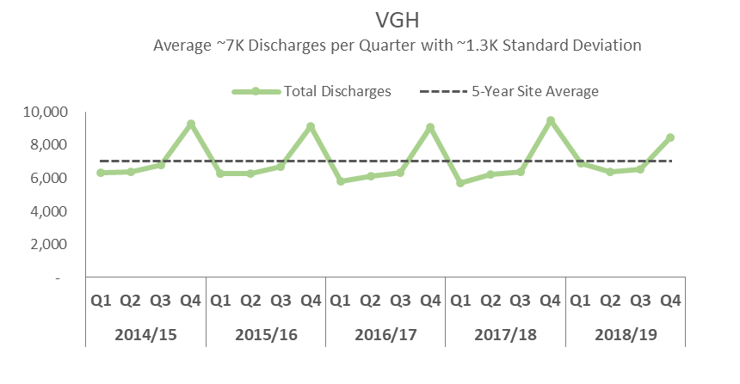
A Multi Site View of Selected Key Performance Indicators
FY 2014/15 Q1 to FY 2018/19 Q4
Structure
Provide brief introduction
Present graph
Include relevant information, such as,
Definition
Calculation (Numerator/Denominator)
Target (if any)
Inclusions
Exclusions
Limitations
Any additional note

Slide 2
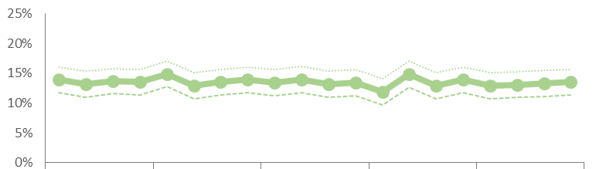
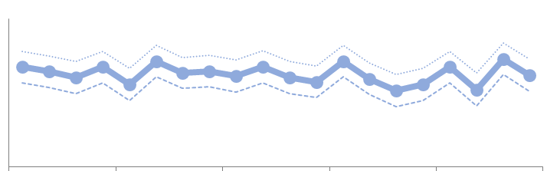
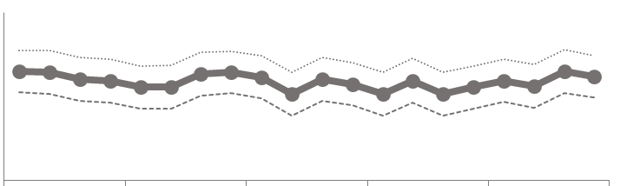
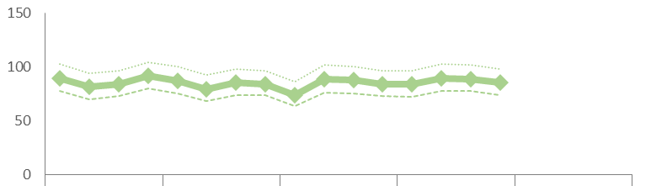
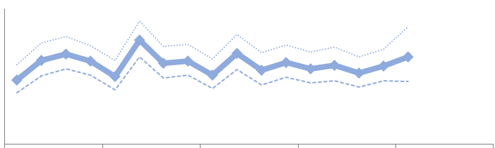
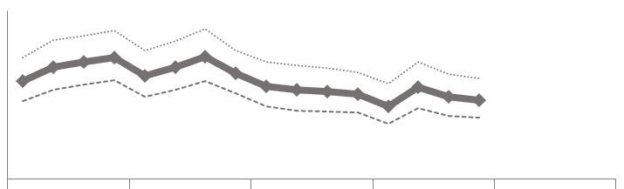
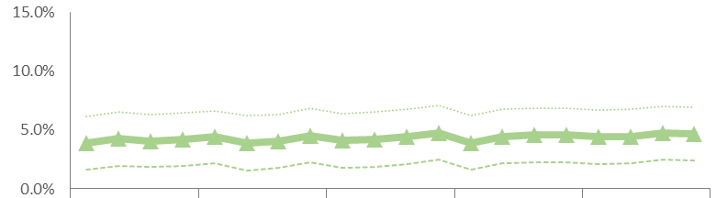
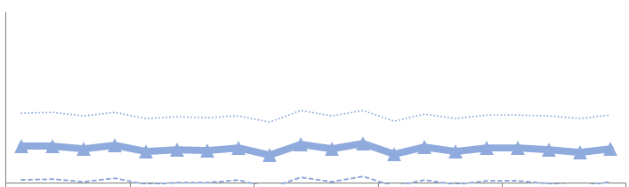
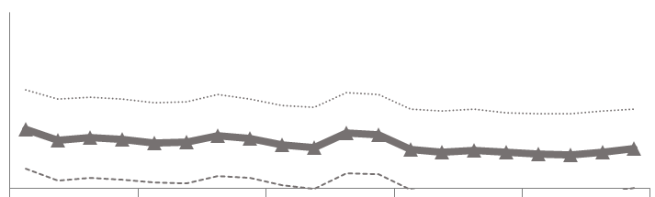
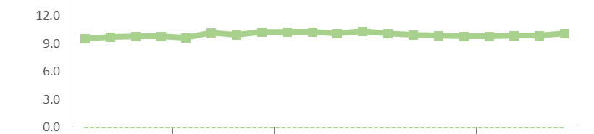
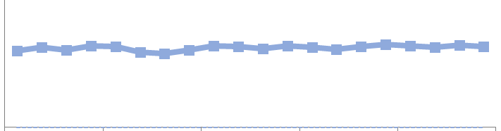
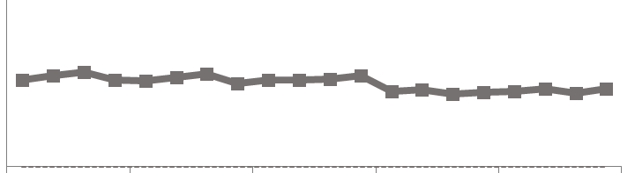
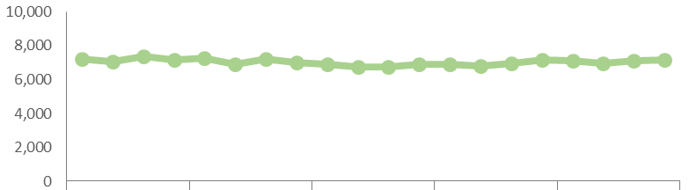
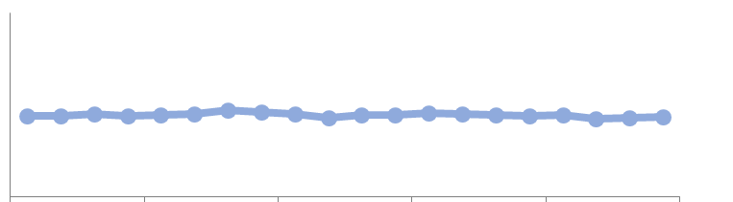
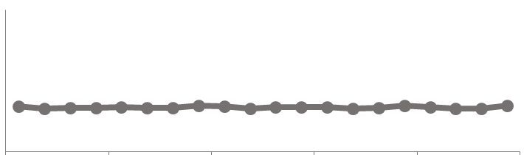
A Multi Site View of Selected Key Performance Indicators: All Population Segments (Age 18 & Above)
FY 2014/15 Q1 to FY 2018/19 Q4
Mock Up
VGH
SPH
LGH
Observations
Most recent quarter is ~16%
Most recent quarter is ~16%
XXXXXXXXXXXXXXXX
YYYYYYYYYY
ZZZZZZZZZZZZZ
Readmission Rate
Upper Limit
Most recent quarter is ~14%
Not real data
Lower Limit
5-year average is ~13%
5-year average is ~16%
5-year average is ~15%
HSMR
Upper Limit
Most recent quarter is ~85
Most recent quarter is ~97
Most recent quarter is ~71
XXXXXXXXXXXXXXXX
YYYYYYYYYY
ZZZZZZZZZZZZZ
Lower Limit
5-year average is ~85
5-year average is ~89
5-year average is ~88
Mortality Rate
Upper Limit
Most recent quarter is ~5%
Most recent quarter is ~3%
Most recent quarter is ~3%
XXXXXXXXXXXXXXXX
YYYYYYYYYY
ZZZZZZZZZZZZZ
Lower Limit
5-year average is ~3%
5-year average is ~4%
5-year average is ~4%
Discuss spread
Most recent quarter is ~10 days
Avg. Length of Stay (Days)
Most recent quarter is ~9 days
Most recent quarter is ~7 days
XXXXXXXXXXXXXXXX
YYYYYYYYYY
ZZZZZZZZZZZZZ
5-year average is ~10 days, with standard deviation of ~16 days
5-year average is ~9 days, with standard deviation of ~15 days
5-year average is ~7 days, with standard deviation of ~14 days
Total Discharges
Most recent quarter is ~7K
Discuss spread
Most recent quarter is ~5K
Most recent quarter is ~3.9K
XXXXXXXXXXXXXXXX
YYYYYYYYYY
ZZZZZZZZZZZZZ
5-year average is ~7K/quarter
5-year average is ~4.5K/quarter
5-year average is ~3.2K/quarter
Quarter/Fiscal Year
CST Implementation

Slide 3
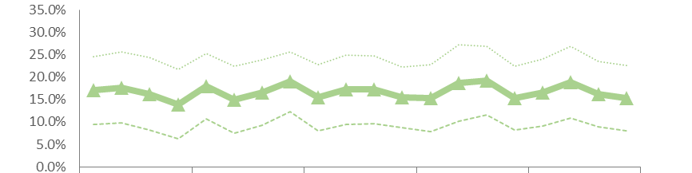
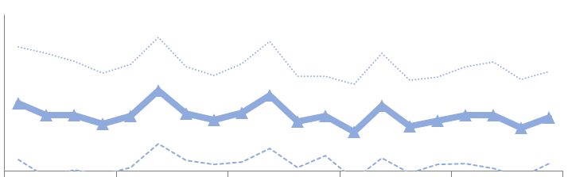
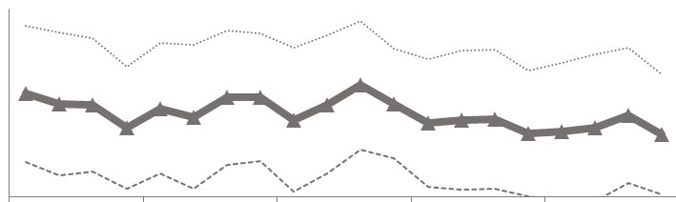
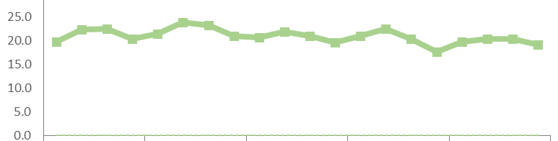
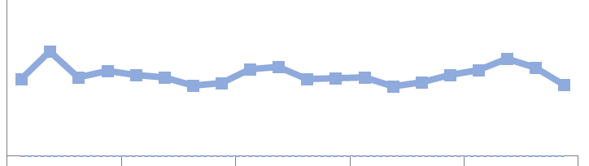
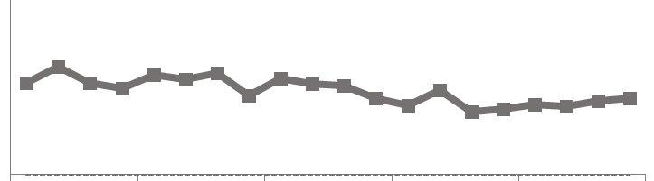
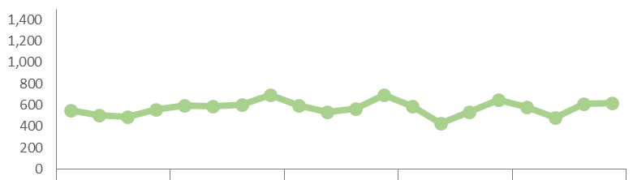
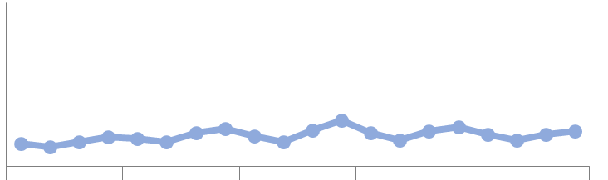
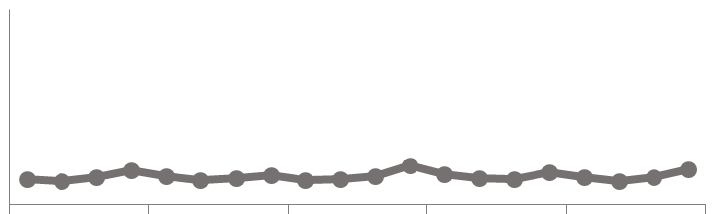
A Multi Site View of Selected Key Performance Indicators: Population with Pneumonia (Age 18 & Above)
FY 2014/15 Q1 to FY 2018/19 Q4
Mock Up
VGH
SPH
LGH
Observations
XXXXXXXXXXXXXXXX
YYYYYYYYYY
ZZZZZZZZZZZZZ
Readmission Rate
Waiting for internal data
Waiting for external data
HSMR
XXXXXXXXXXXXXXXX
YYYYYYYYYY
ZZZZZZZZZZZZZ
Upper Limit
Most recent quarter is ~15%
Most recent quarter is ~12%
Most recent quarter is ~12%
Mortality Rate
5-year average is ~17%
5-year average is ~12%
5-year average is ~15%
XXXXXXXXXXXXXXXX
YYYYYYYYYY
ZZZZZZZZZZZZZ
Lower Limit
Most recent quarter is ~19 days
Most recent quarter is ~13 days
Most recent quarter is ~13 days
Avg. Length of Stay (Days)
5-year average is ~21 days, std. dev. ~28 days
5-year average is ~15 days, std. dev. ~23 days
5-year average is ~14 days, std. dev. ~25 days
XXXXXXXXXXXXXXXX
YYYYYYYYYY
ZZZZZZZZZZZZZ
Total Discharges
Most recent quarter is ~600
Most recent quarter is ~300
Most recent quarter is ~300
XXXXXXXXXXXXXXXX
YYYYYYYYYY
ZZZZZZZZZZZZZ
5-year average is ~600/quarter
5-year average is ~300/quarter
5-year average is ~200/quarter
Quarter/Fiscal Year
CST Implementation

Slide 4
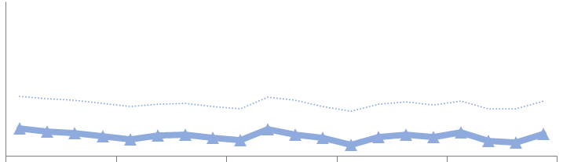
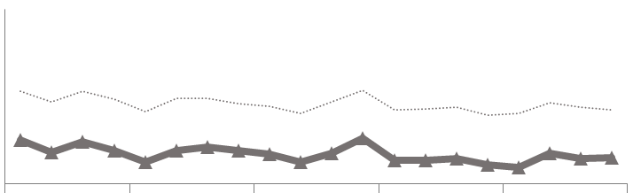
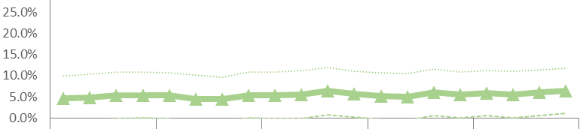
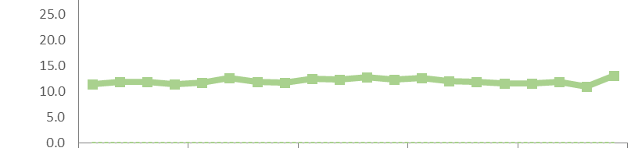
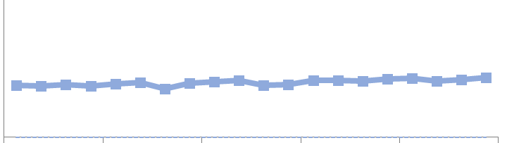
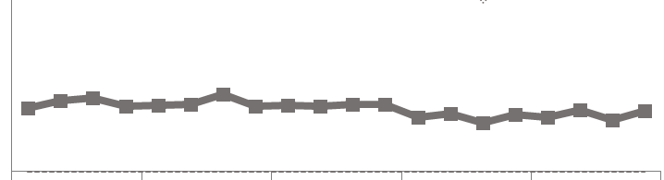
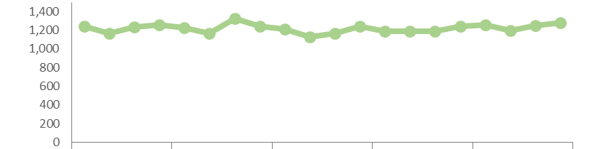
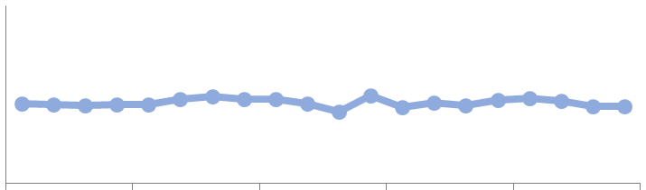
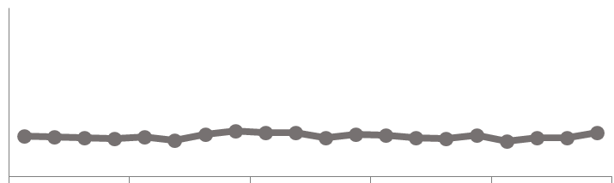
A Multi Site View of Selected Key Performance Indicators: Population with Heart Failure (Age 18 & Above)
FY 2014/15 Q1 to FY 2018/19 Q4
Mock Up
VGH
SPH
LGH
Observations
XXXXXXXXXXXXXXXX
YYYYYYYYYY
ZZZZZZZZZZZZZ
Readmission Rate
Waiting for internal data
Waiting for external data
HSMR
XXXXXXXXXXXXXXXX
YYYYYYYYYY
ZZZZZZZZZZZZZ
Most recent quarter is ~6%
Most recent quarter is ~5%
Most recent quarter is ~5%
Mortality Rate
Upper Limit
5-year average is ~5%
5-year average is ~4%
5-year average is ~6%
XXXXXXXXXXXXXXXX
YYYYYYYYYY
ZZZZZZZZZZZZZ
Lower Limit
Most recent quarter is ~13 days
Most recent quarter is ~13 days
Most recent quarter is ~10 days
Avg. Length of Stay (Days)
5-year average is ~12 days, std. dev. ~18 days
5-year average is ~12 days, std. dev. ~19 days
5-year average is ~10 days, std. dev. ~18 days
XXXXXXXXXXXXXXXX
YYYYYYYYYY
ZZZZZZZZZZZZZ
Most recent quarter is ~1,300
Most recent quarter is ~600
Most recent quarter is ~400
Total Discharges
5-year average is ~1,200/quarter
5-year average is ~700/quarter
5-year average is 400~/quarter
XXXXXXXXXXXXXXXX
YYYYYYYYYY
ZZZZZZZZZZZZZ
Quarter/Fiscal Year
CST Implementation

Slide 5
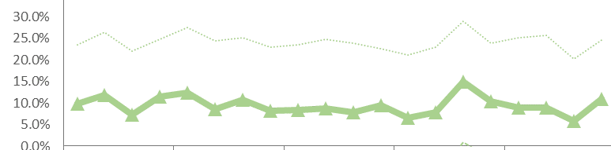
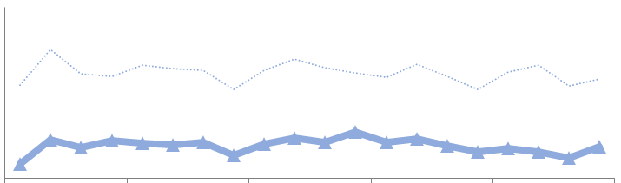
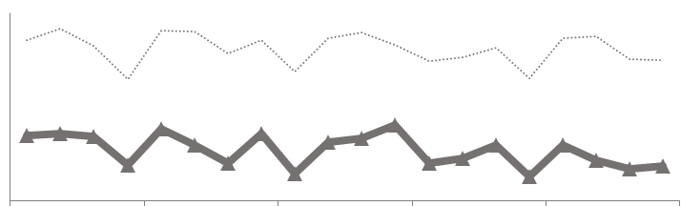
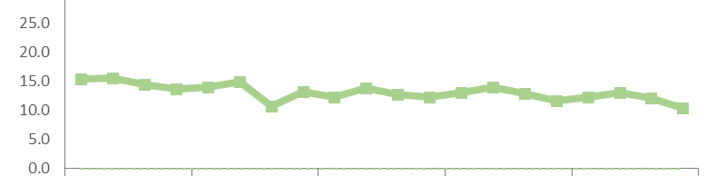
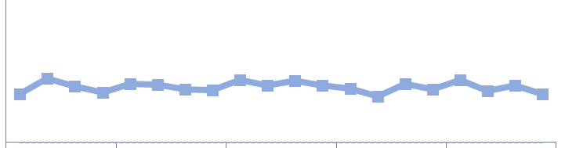
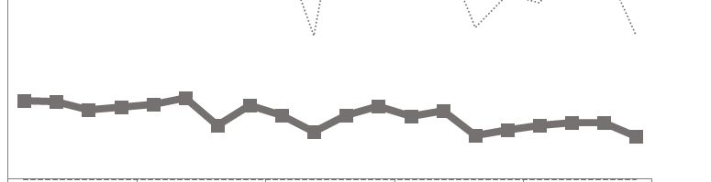
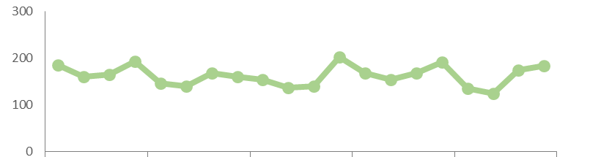
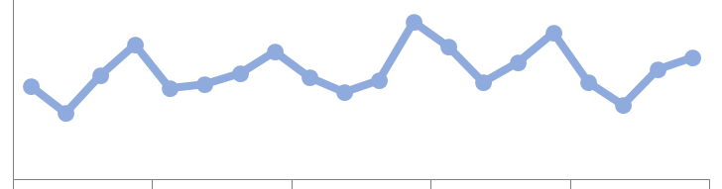
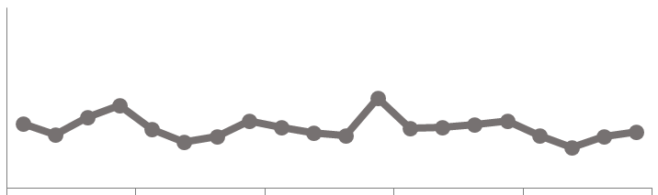
A Multi Site View of Selected Key Performance Indicators: Population with COPD (Age 18 & Above)
FY 2014/15 Q1 to FY 2018/19 Q4
Mock Up
VGH
SPH
LGH
Observations
XXXXXXXXXXXXXXXX
YYYYYYYYYY
ZZZZZZZZZZZZZ
Readmission Rate
Waiting for internal data
Waiting for external data
HSMR
XXXXXXXXXXXXXXXX
YYYYYYYYYY
ZZZZZZZZZZZZZ
Most recent quarter is ~11%
Most recent quarter is ~6%
Most recent quarter is ~7%
Mortality Rate
Upper Limit
5-year average is ~9%
5-year average is ~7%
5-year average is ~9%
XXXXXXXXXXXXXXXX
YYYYYYYYYY
ZZZZZZZZZZZZZ
Lower Limit
Most recent quarter is ~10 days
Most recent quarter is ~9 days
Most recent quarter is ~7 days
Avg. Length of Stay (Days)
5-year average is ~13 days, std. dev. ~18 days
5-year average is ~11 days, std. dev. ~16 days
5-year average is ~11 days, std. dev. ~15 days
XXXXXXXXXXXXXXXX
YYYYYYYYYY
ZZZZZZZZZZZZZ
Most recent quarter is ~200
Most recent quarter is ~200
Most recent quarter is ~100
Total Discharges
5-year average is ~200/quarter
5-year average is ~200/quarter
5-year average is ~100/quarter
XXXXXXXXXXXXXXXX
YYYYYYYYYY
ZZZZZZZZZZZZZ
Quarter/Fiscal Year
CST Implementation

Slide 6
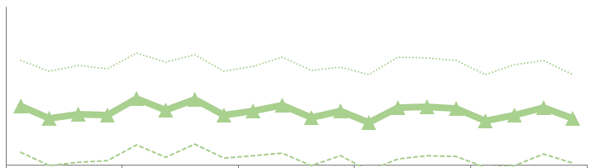
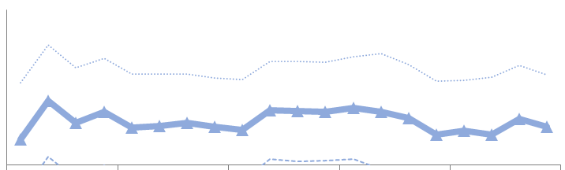
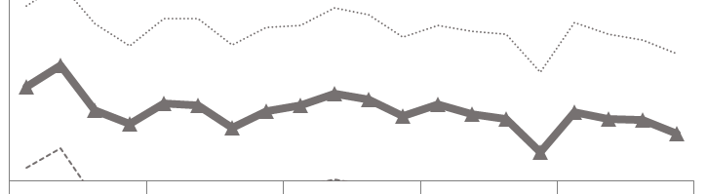
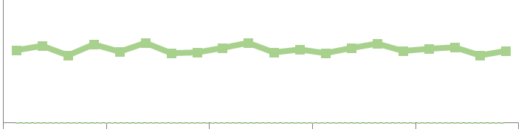
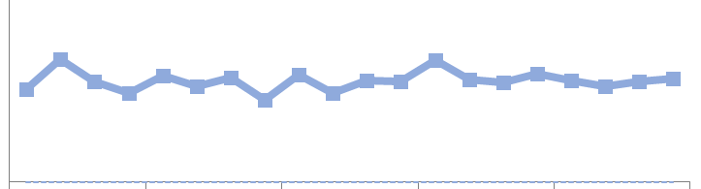
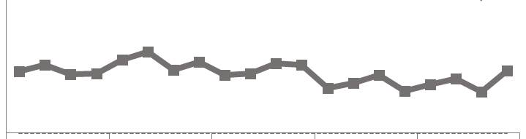
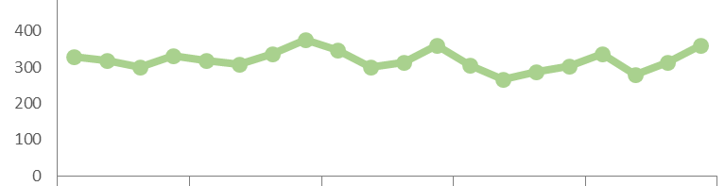


A Multi Site View of Selected Key Performance Indicators: Population with Diarrhea (Age 18 & Above)
FY 2014/15 Q1 to FY 2018/19 Q4
Mock Up
VGH
SPH
LGH
Observations
XXXXXXXXXXXXXXXX
YYYYYYYYYY
ZZZZZZZZZZZZZ
Readmission Rate
Waiting for internal data
Waiting for external data
HSMR
XXXXXXXXXXXXXXXX
YYYYYYYYYY
ZZZZZZZZZZZZZ
Most recent quarter is ~10%
Most recent quarter is ~9%
Most recent quarter is ~9%
Mortality Rate
Upper Limit
5-year average is ~12%
5-year average is ~10%
5-year average is ~13%
XXXXXXXXXXXXXXXX
YYYYYYYYYY
ZZZZZZZZZZZZZ
Lower Limit
Most recent quarter is ~15 days
Most recent quarter is ~16 days
Most recent quarter is ~13 days
Avg. Length of Stay (Days)
5-year average is ~16 days, std. dev. ~21 days
5-year average is ~16 days, std. dev. ~22 days
5-year average is ~13 days, std. dev. ~19 days
XXXXXXXXXXXXXXXX
YYYYYYYYYY
ZZZZZZZZZZZZZ
Most recent quarter is ~400
Most recent quarter is ~300
Most recent quarter is ~200
Total Discharges
5-year average is ~300/quarter
5-year average is ~200/quarter
5-year average is 100~/quarter
XXXXXXXXXXXXXXXX
YYYYYYYYYY
ZZZZZZZZZZZZZ
Quarter/Fiscal Year
CST Implementation

Slide 7
A Multi Site View of Selected Key Performance Indicators: Population with Pneumonia (Age 18 & Above)
FY 2014/15 Q1 to FY 2018/19 Q4
Mock Up
Tag Line/ Cross Site Observations
VGH
SPH
LGH
XXXXXXXXXXXXXXXX
YYYYYYYYYY
ZZZZZZZZZZZZZ
XXXXXXXXXXXXXXXX
YYYYYYYYYY
ZZZZZZZZZZZZZ
XXXXXXXXXXXXXXXX
YYYYYYYYYY
ZZZZZZZZZZZZZ
Site Specific Observations

Slide 8
A Multi Site View of Selected Key Performance Indicators: Population with Heart Failure (Age 18 & Above)
FY 2014/15 Q1 to FY 2018/19 Q4
Template
VGH
SPH
LGH
Observations
XXXXXXXXXXXXXXXX
YYYYYYYYYY
ZZZZZZZZZZZZZ
Readmission Rate
HSMR
XXXXXXXXXXXXXXXX
YYYYYYYYYY
ZZZZZZZZZZZZZ
Most recent quarter is ~%
Most recent quarter is ~%
Most recent quarter is ~%
Mortality Rate
Upper Limit
5-year average is ~%
5-year average is ~%
5-year average is ~%
XXXXXXXXXXXXXXXX
YYYYYYYYYY
ZZZZZZZZZZZZZ
Lower Limit
Most recent quarter is ~ days
Most recent quarter is ~ days
Most recent quarter is ~13 days
Avg. Length of Stay (Days)
5-year average is ~12 days, std. dev. ~ days
5-year average is ~ days, std. dev. ~ days
5-year average is ~14 days, std. dev. ~14 days
XXXXXXXXXXXXXXXX
YYYYYYYYYY
ZZZZZZZZZZZZZ
Most recent quarter is ~
Most recent quarter is ~
Most recent quarter is ~
Total Discharges
5-year average is ~/quarter
5-year average is ~/quarter
5-year average is ~/quarter
XXXXXXXXXXXXXXXX
YYYYYYYYYY
ZZZZZZZZZZZZZ
Quarter/Fiscal Year
CST Implementation

